Slide 1

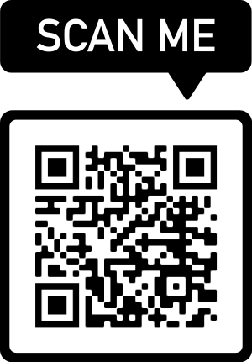
Wi-Fi Indoor Localization Dataset (WILD-v2)
1st International Workshop on Wireless AI and Perception (WAIP)
Roshan Ayyalasomayajula

Slide 2
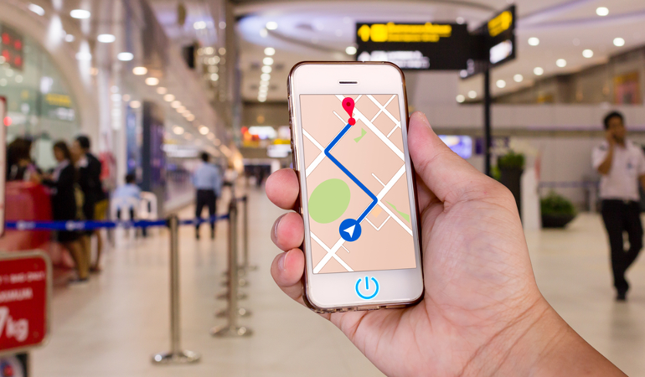
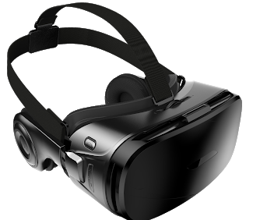
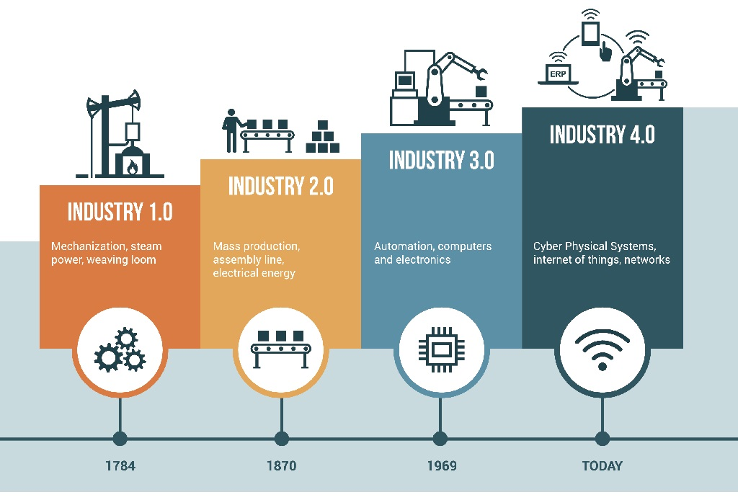
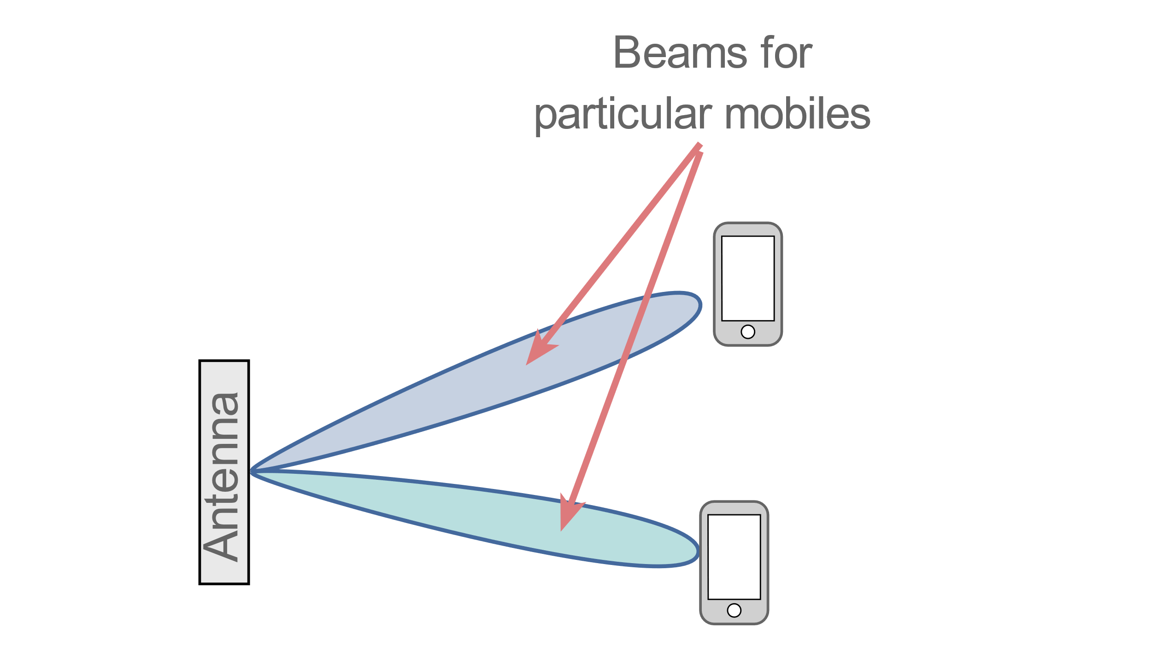
Indoor Localization: Applications
Navigation
AR/VR/XR
Efficient Communication
IIoT-4.0
Notes:
For enabling many of the indoor sensing applications like AR, VR, robotic surgeries, indoor navigation require exact user locations.
(c)
Further the latest generation of Industrial IoT devices all work with wireless sensing which further demands to know their exact location so as to be able to function appropriately
(c)
Even the 5G communication which works based on beamforming needs to know the exact user location for efficient beamforming.
So, Location is the key enabler of these applications, so they need their own location and they need to know the context of their locations
(c)

Slide 3

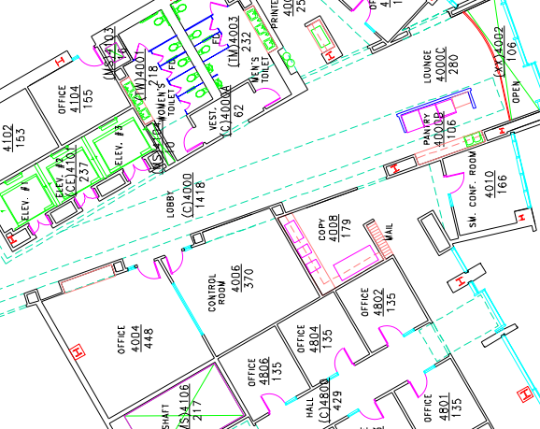
Wi-Fi based Indoor Localization
MonoLoco MobiSys'18
Chronos NSDI'16
ToneTrack Mobicom'15
SpotFi Sigcomm'15
ArrayTrack NSDI'13
Median: few decimeters
>10% of cases: few meters
Notes:
And WiFi is one of the protocls that is widely looked into owing to its wide deployment
(c)
But, while there have been 2 decades of research in WiFi based indoor localization that profess to achieve
(c)
a median localization performance accurate to few decimeters, which can be shown to be sufficient to locate the user in an indoor environment
(c)
There are more than
(c)
10% cases where the localization performance goes as inaccurate as few meters, this makes it hard to locate the user or perform accurate tracking for IoT devices in industrial settings…
So how do we overcome this limitation to get accurate WiFi based locazalition? To understand let us see what causes these issues
(c)

Slide 4
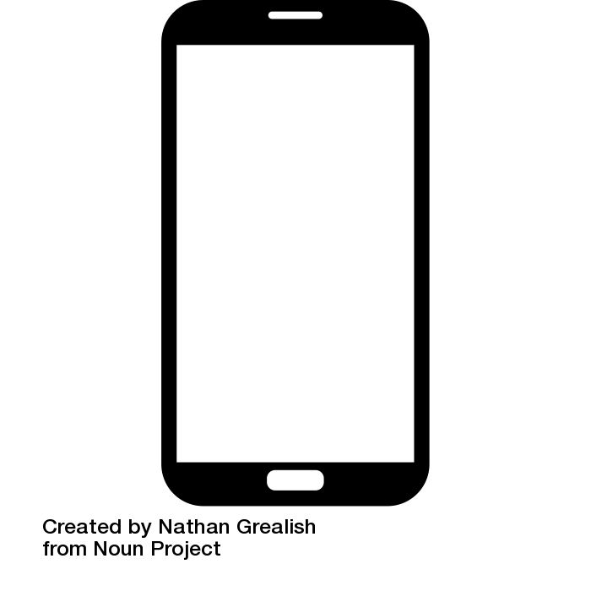



Challenge: Multipath, Non-Line of Sight
Reflector
Smartphone
r
θ
Obstacle
Need Knowledge of Environment
AP
Notes:
The main challenges for accurate localization are multipath and non-line of sight…
To understand what these are..
(c)
Consider a smartphone talking to an access point..
the signal from the smartphone does not just come to the access point in one direct path
(c)
But rather along multiple paths
and we don’t know which of these is the correct path.
This is a fundamental problem of multipath in localization
(c)
What makes things worse is if the direct path is blocked and the access point can only receive the reflected path.
So, now I have no information from the direct path and so I cannot get the actual estimation of the correct path. Right!
So, how can I get the actual location in either of these cases?
(c)
If I knew exactly what and where these obstacles and reflectors are, I can get the location of the user.
But unfortunately, to describe these properties is extremely complex and
(c)

Slide 5
Deep Learning Based Wi-Fi Localization
Maximillian Arnold et. al., SCC 2019
Michal Nowicki et. al., ICA, 2017
Xuyu Wang, et al., IEEE Access 5, 2017
Xialong Zheng, et al., IEEE/ACM Transactions on Networking, 2017
DLoc
Mobicom 2020
Wanda Song et al
ICEIB 2021
SE-Loc
ToN 2022
DLoc/WILD
Mobicom 2020
Notes:
This is where learning based techniques where we could learn an implicit model of the environment and localize accurately.
(c)
Inspired by this intuition there have been a lot of works that use learning based algorithms for performing accurate WiFi localization.
But the problem was that all the algorithms have been tested in their own private settings and datasets
So there is no common benchmark against which everything can be tested.
(c)
To overcome this we have for the first time open-sourced the largest labelled CSI dataset called
(c)

Slide 6
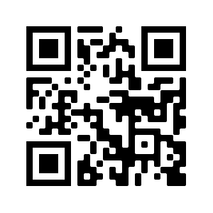
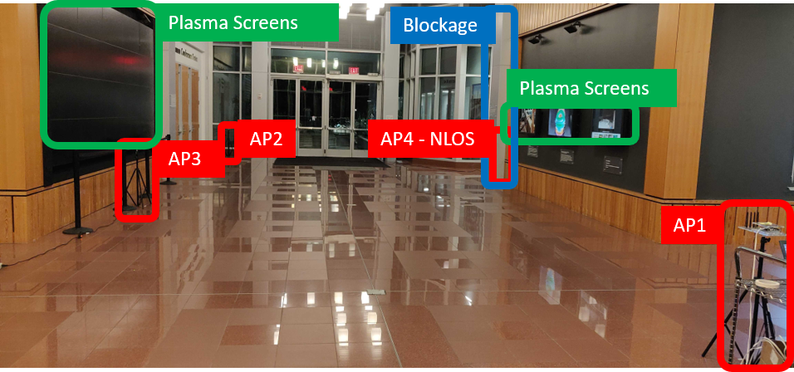
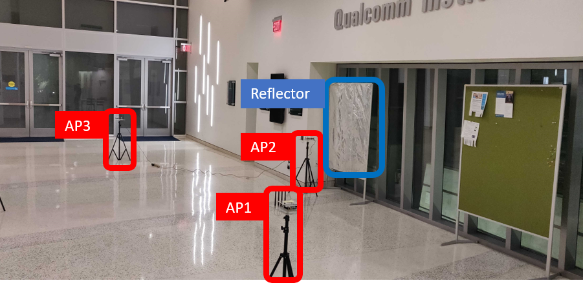
Wireless Indoor Localization Dataset (WILD)
2 different environments
8 different settings
108k datapoints
Download Statistics:
~100 different researchers
Across >50 research centres
Notes:
Wireless Indoor Localization Dataset in mid of 2020..
(c)
Which contains data collected over 2 different environments as shown with ample amount of reflectors and non-line of sight conditions for the access points
(c)
And 8 different environments with various furniture in the environment moved around collecting a total of more than 100 thousand datapoints
(c)
And Over the past 2 years, this data has been accessed by around 100 different researchers spread across more than 50 research centres. We were able to collect this vast amount datasets thanks to the robot that we have built called
(c)

Slide 7
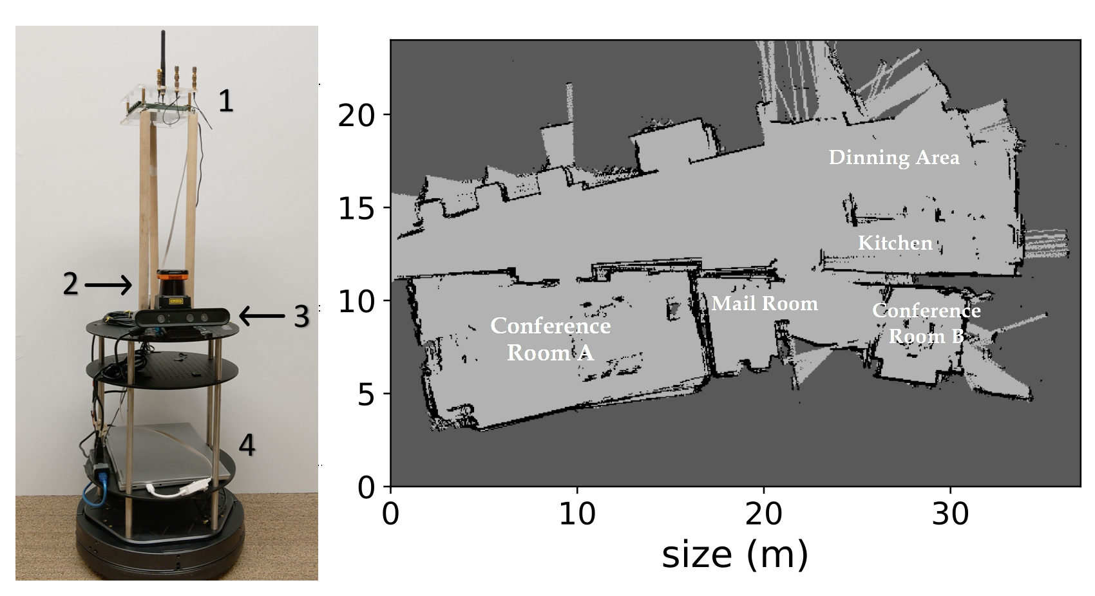
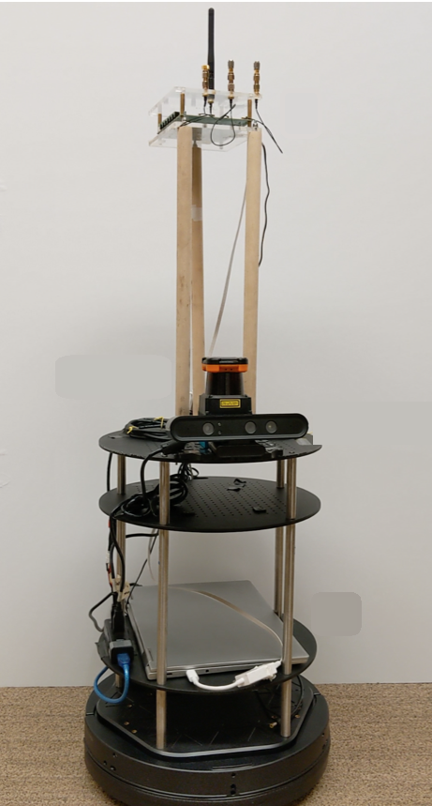


MapFind
WiFi Client
LiDAR
RGB-D
Server
Kobuki
Notes:
MapFind
(c)
with multiple visual sensors like LiDAR and RGBD camera that are mounted on a Kobuki base and has a local server that with the help of SLAM algorithms goes around and maps the space
Further, it also has a wifi client that reports the channel information for each bot’s location across all the wifi access points in the environment
(c)
So, this bot moves around an unknown space mapping it, just as we want it, with all those details of desk, chairs, etc. just like your Roomba
and it also collects wireless data using the WiFi client mount atop it labelling the channel information data with the location provided within the context of the map, which we can use in our learning models as a benchmark
But how accurate are these location ground truth labels provided by the robot?
(c)

Slide 8
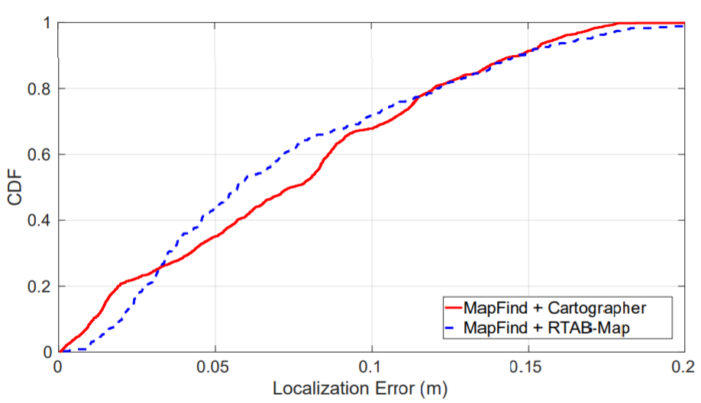
MapFind Labelling Accuracy
Notes:
To test the same, we mounted a VR headset over our MapFind bot and navigate our bot in an indoor space.
The VR headset is accurate to a mm and when compared to this ground truth we have observed that MapFind’s ground truth locations have a median error of only 6cm with both of the state-of-the-art robot slam algorithms Cartographer and RTABMap

Slide 9
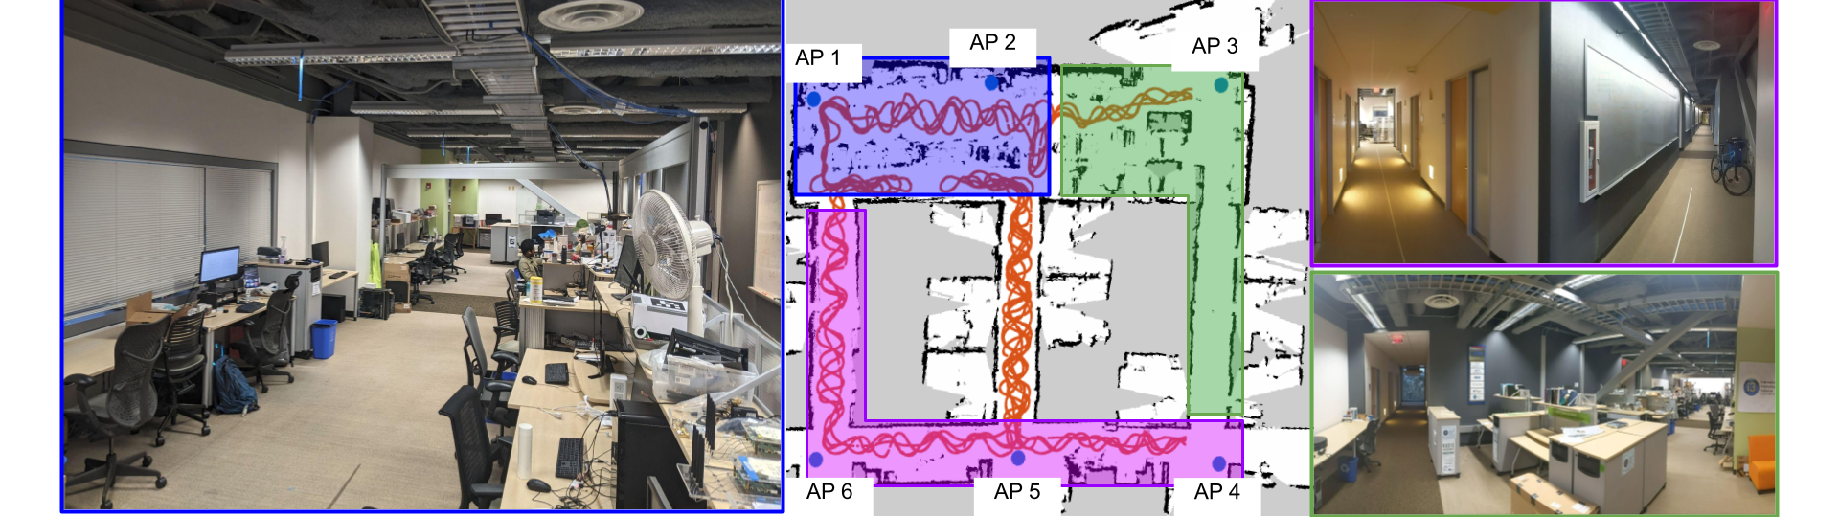
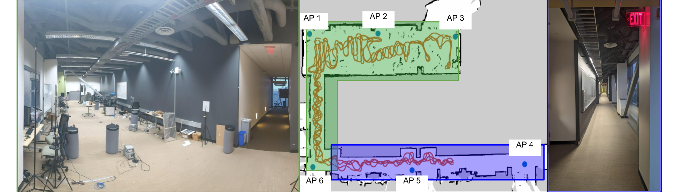
WILD-v2 and Kaggle Competition
Env-1
https://www.kaggle.com/c/wild-v2
Env-2
Notes:
We aim to continuously increase these datasets and enable benchmarking and so
(c)
to do that we have collected two more datasets in a more realistic office settings of size 40mx20m with 6 wifi access points deployed in each environment independently
(c)
And have started a Kaggle competition that you can access at the following link or by scanning the QR code above

Slide 10
Competition Objective: Generalization
Environment-1
Environment-2
Train
&
Test
Train
Simple Evaluation
Train
(G1) Space Generalization Evaluation
Test
(G2) Environment Generalization Evaluation
Train
Test
Train

Slide 11
Competition Timeline
1 May, 2022: Competition is live
5 Sept, 2022: Deadline for a team entry. Teams should agree to the terms and conditions by this date.
5 Sept, 2022: Deadline for team merger
Tentative 15 Sept, 2022: Deadline for the Final Submission
All deadlines are at 11:59 PM PDT on the days mentioned. The competition hosts reserve the right to update the contest timeline if they deem it necessary.

Slide 12
Evaluation Metrics
Location errors are calculated as Root Mean Square Errors (L2 norm/Euclidean Norm)
These distance errors form a distribution from which the 50th and 95th percentile are estimated and averaged for the 3 evaluation scenarios
1
0.9
0.7
CDF
0.5
Simple Evaluation
0.3
Space Generalization
0.1
Env Generalization
0
Localization RMSE (m)

Slide 13
Leaderboard and Prizes
Public Leaderboard
Simple Evaluation
Private Leaderboard:
G1+G2 results averaged
Used for final Prize distribution
Prizes:
5K $
3K $
2K $

Slide 14
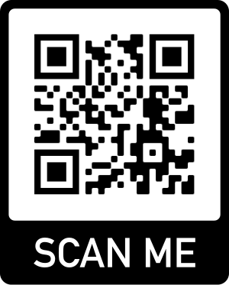
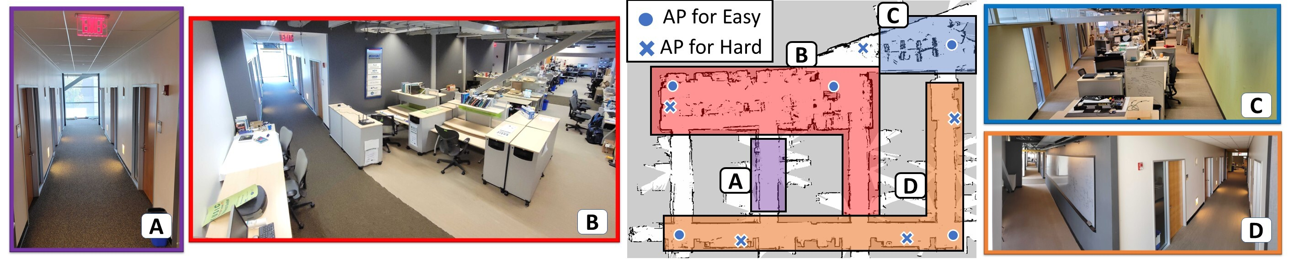
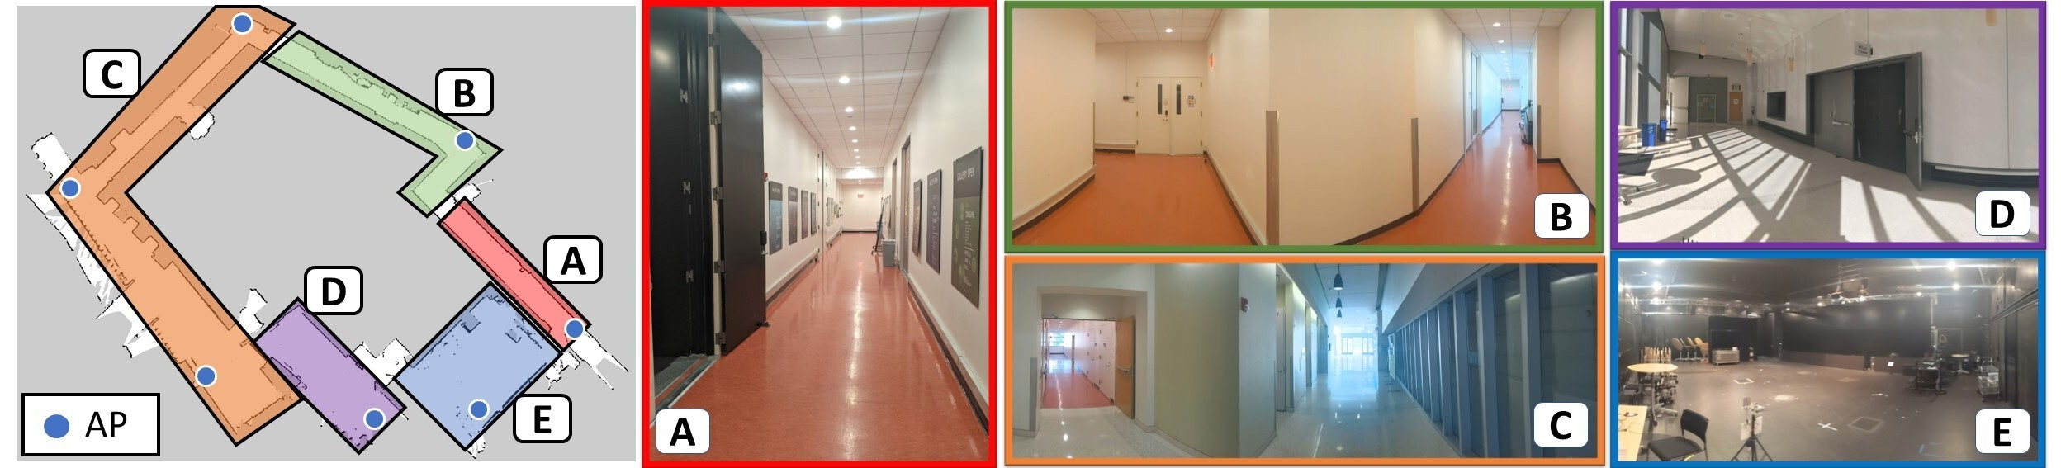
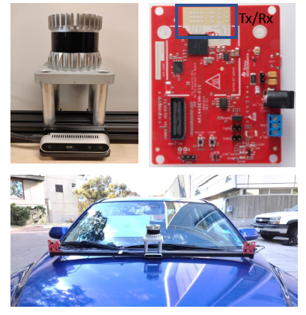
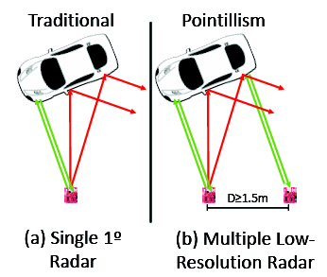
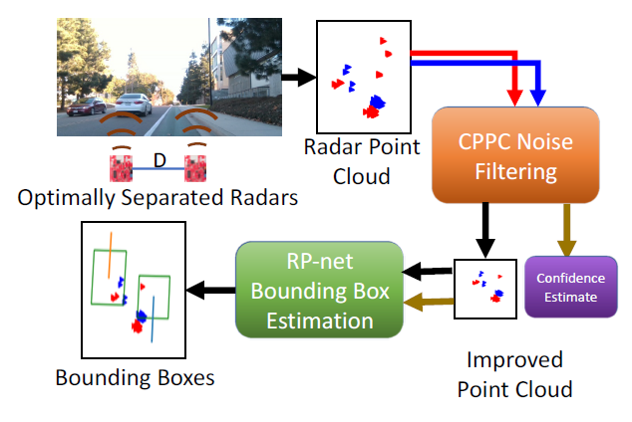
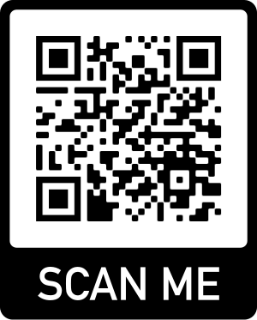
Other Open Sourced RF Datasets
P2SLAM: Indoor Robotic Navigation and SLAM Datasets
Pointillism: Accurate 3D Bounding Box Estimation with Multi-Radars

Slide 15
Summary of all the Datasets
WILD-v2
Kaggle Competition
WILD-v1
P2SLAM
Pointillism

